Slide 1

Course Name: Hardware Security
Faculty Name: Prof Debdeep Mukhopadhyay
Department : Computer Science and Engineering
Topic
Lecture 25: Power Analysis-I

Slide 2

Concepts Covered:
Working Principle of DPA
Toy Example
Difference-of-Mean (DOM) Method
DOM on AES

Slide 3
Power Attacks
SPA – Simple Power Analysis attacks
Fact exploited - Power consumption at an instant of time is a function of the operation being carried out by the device
DPA – Differential Power Analysis
Fact exploited - Power consumption of the same operation at different instants of time depends on the data being processed.

Slide 4
Simple Power Analysis (SPA)
Directly interprets the power consumption of the device
Looks for the operations taking place and also the key!
Trace: A set of power consumptions across a cryptographic process
1 millisecond operation sampled at 5MHz yield a trace with 5000 points

Slide 5
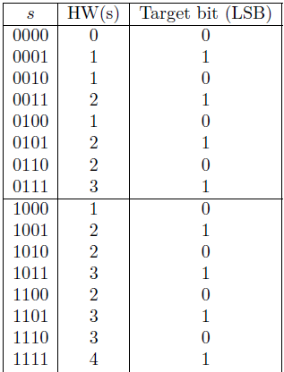
Principle of DPA
Assume power leakage follows Hamming Weight.
Divide the HW(s) into two bins:
0 bin: when LSB is 0
1 bin: when LSB is 1
Difference-of-Mean (DoM)=20/8-12/8=1

Slide 6
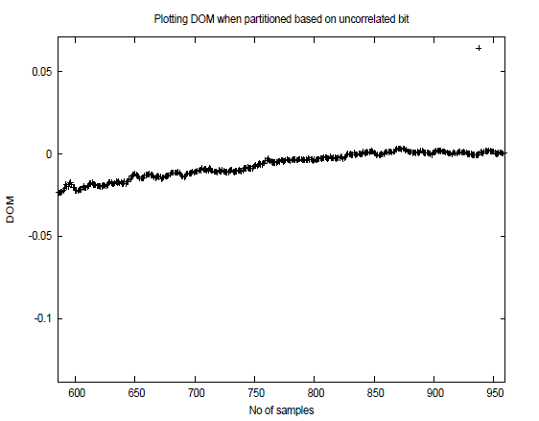
When the partitioning is done wrt. an uncorrelated bit?
Parititioning done by bits simulated using rand function in C.
Observe the DoM is close to 0, as expected!

Slide 7
A Toy DPA
Consider the operation z=y^{x}mod 256
Assume attacker knows first 4 bits of the secret, x.
Probability of guessing the next bit of x is ½ (with no side channel information).
Now we assume, the attacker varies y and obtains several power traces.
We simulate them through Hamming Weights.

Slide 8
A Toy DPA
For a given y, the attacker now guesses the next bit and computes the probable s after the 3rd iteration (note that square and multiply starts from bit 6 to bit 0).
Based on the LSB of y, the corresponding trace is put into the 0 bin or 1 bin.
For every guess (there are 2 guesses) the DoM is computed and plotted.
The correct guess is expected to provide large DoM.

Slide 9
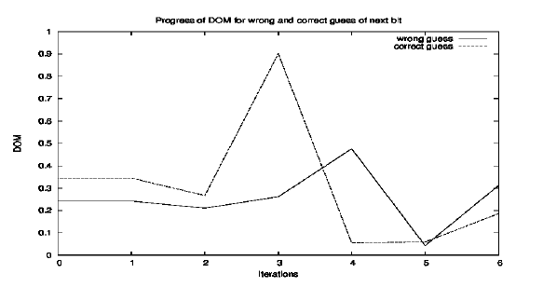
A Toy DPA
Correct Key is 0x8F
Next bit is thus 1.
DoM computed after 2¹⁰ traces.
Significant difference: 0.9 vs 0.2!

Slide 10
DPA Overview
Introduced by P. Kocher and colleagues
More powerful and more difficult to prevent than SPA
Different power consumption for different state (0 or 1)
Data collection phase and data analysis phase
Procedure
Gather many power consumption curves
Assume a key value
Divide data into two groups(0 and 1 for chosen bit)
Calculate mean value curve of each group
Correct key assumption → not negligible difference

Slide 11

D. Stinson, Cryptography: Theory and Practice, Chapman & Hall/CRC
Lawrence C. Washington, Elliptic Curves: Number Theory and Cryptography, Chapman & Hall/CRC
Jeffrey Hoffstein, Jill Pipher, Joseph H. Silverman, An Introduction to Mathematical Cryptography, Springer.

Slide 12


